Slide 1
SIKHS & SIKHISM - SIMPLIFIED
AS I SEE IT OR AS I WOULD LIKE TO SEE IT
SWARN SINGH KAHLON
www.sikhglobalvillage.com
IAS ACADEMY, MUSSOURIE
21 & 22 May, 2012
Notes:
Emphasis on I would like to see it

Slide 2
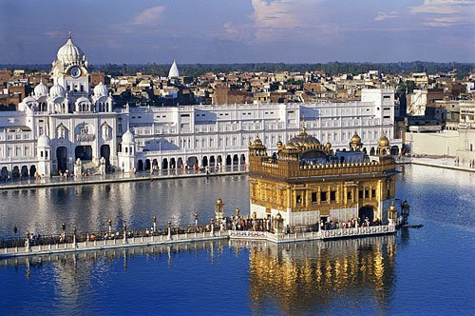
GOLDEN TEMPLE AMRITSAR

Slide 3
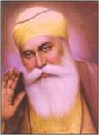
GURU NANAK

Slide 4
INTRODUCTION
Thanks, introductions and apology
To be a True Sikh – very challenging
Definition of religion
Religious beliefs at times sensitive to questioning and debate - matters of faith. Time frozen. Generally hereditary.
Focus of my talk on non-spiritual aspects. More emphasis on day to day living as a Sikh
Notes:
Ranjana – learn my religion. Xalapa, Satguru Singh Khalsa. Religion supernatural power, creator of universe. Time frozen.
Born into a religion. You are not choosing a religion like a career.

Slide 5
SIKHISM
Young religion – 500 years old
Ten Gurus starting with Guru Nanak
Tenth Guru Gobind Singh
Sri Guru Granth Sahib – a living Guru
Sikh Gurus were not Prophets but living family pious men.
Started as Social Reform to overcome the ills of society which had become supine.
Modern concepts.
Notes:
Langar, Chhabil, Women reservation, nagar keertan, ban on smoking. 1469 and 1699

Slide 6
SIKHISM AS VISIONED BY THE GURUS
Guru Nanak called upon mankind to rise and realise its potential, to invoke its divine strength and stand up to evil. He proclaimed the universal brotherhood of man, right to freedom of belief, equality of women, and benign governance. The other Gurus provided the continuum and finally Guru Gobind Singh institutionalised and codified the movement through creation of Khalsa.
Sikhism is a way of life based on these values and examples set out by the Gurus and enshrined in the SGGS.

Slide 7
Some Historical Milestones
Guru Nanak, a social activist and Bhakt
Guru Arjun – Martyrdom, Golden Temple and SGGS
Guru Tegh Bahadur – Died for upholding liberty of conscious and belief. A unique sacrifice to defend Kashmiri Pandits’ right to follow their beliefs
Guru Gobind Singh created Khalsa, Saint Soldier or Religious Knighthood.
No more living Gurus – Sri Guru Granth Sahib as the future guide. Importance of shabad/message. .

Slide 8
SRI GURU GRANTH SAHIB
The Sikh Holy Book
Entire Granth set to music – Unique literary delight besides the religious hymns to the glory of God.
Contains teachings of Sikh Gurus, 15 saints – Hindus and Muslims from across India and others. Frequent ref to Ram and Allah

Slide 9
DEMOCRATIC INSTITUTIONS
Panj Pyaras – Aap Gur Chela, Sarbat Khalsa
No priesthood
Equality of Sexes
Abolition of Zamindari – Banda Bahadur
Langar – Stressing equality of all; Langar at World Religious Conference, Barcelona.
High importance to ‘Sangat’

Slide 10
UNIVERSALITY OF SIKHISM
Panj Pyaras from across India, Bani of non-Sikh saints in SGGS, Foundation of Golden Temple by a Muslim Mian Mir
Concept of Red Cross - Baba Kanhya
Gurus especially Nanak travelled extensively within India and Abroad
Sikh Diaspora - a global presence
Interest in Sikh Studies - Europe, N. America & SEA
‘Sarbat da Bhala’

Slide 11
IMPORTANT GUIDELINES
Live as a family man
Control of five emotions - ‘Kaam, Karodh, Lobh, Moh, Ahankar’.
Developing five virtues –
Sat, Santokh, Daya, Nimrata, Pyaar
Day to day living - Kirit Karni, Wand ke Chhakna, Simran Karna –Naam Japna
Notes:
Physical love,anger,greed,Filial love,ego. Truth,contentment, compassion,humility,love. Sincere hard work,Sharing the riches,pray-sing God’s praises.

Slide 12
GURDWARA
A unique institution
Place for prayers and religious functions
Keertan, an important part of religious service
Langar – community meals
Place to stay
Meeting place for community
Social functions such as marriages
All welcome
Notes:
Four doors.

Slide 13
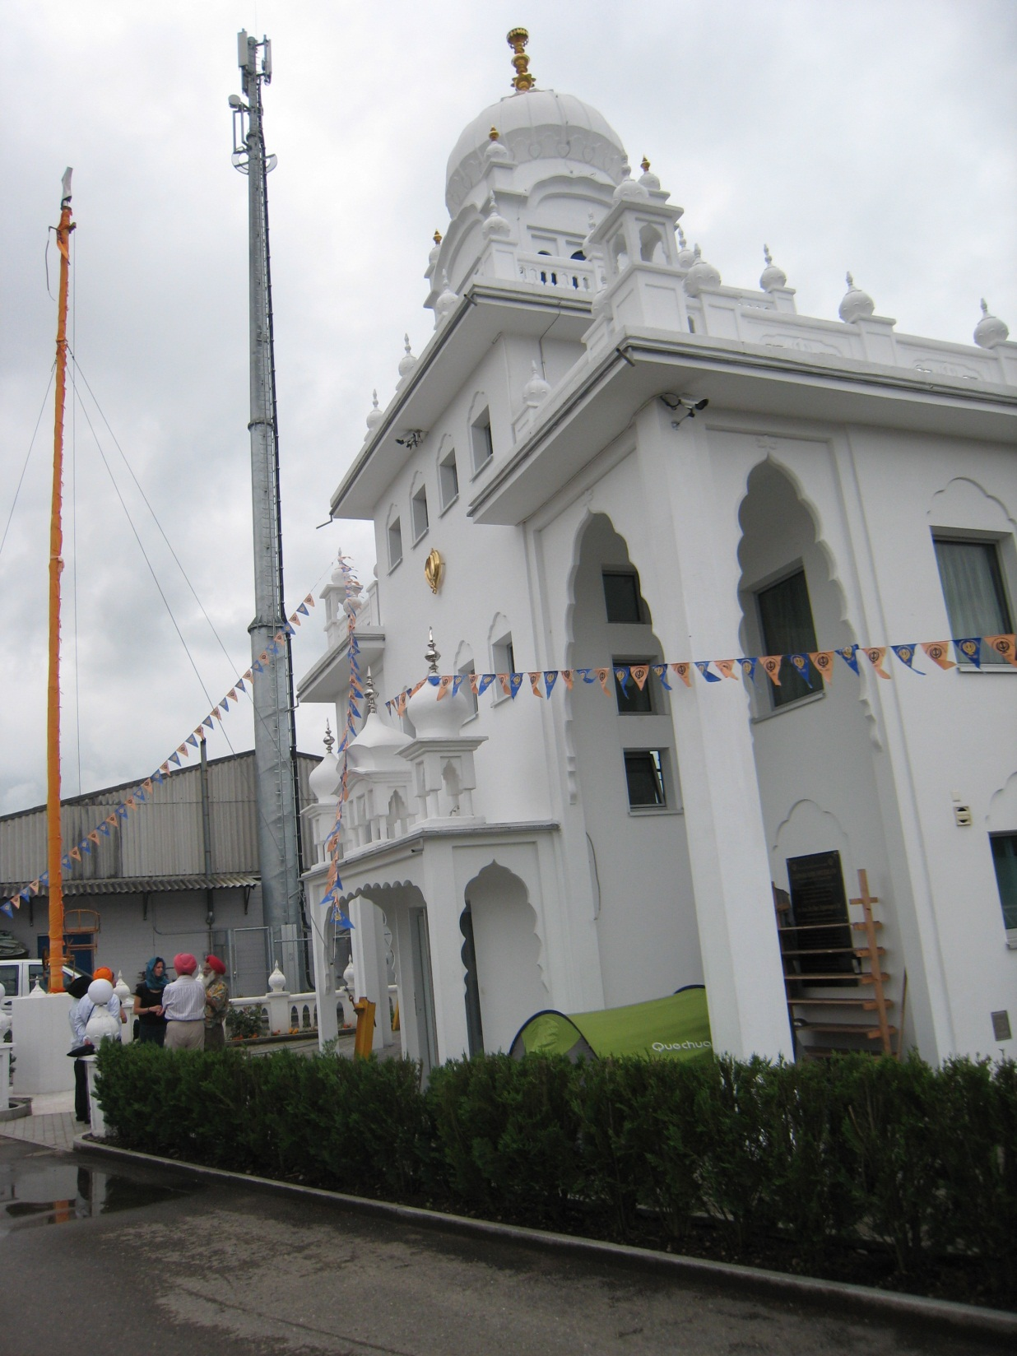

Slide 14
SAINT KNIGHTHOOD
People Empowerment
Shubh Karman se Kabhu na daroon
Fight for justice
Stand out for what you believe in
Sava Laakh se ek laraoon
Chiri da Baaz banaoon
Gurdwara Reform & Kuka Movements

Slide 15
CONCEPT OF MARTIAL RACE AND BRITISH PATRONAGE
Post Maharaja Ranjit Singh and Sikh Wars, Sikh recruitment in Army and Police
Encouraged propagation of religion
Sikh population increase
Sikh migration abroad
Freedom movement – Sikhs played important role. Port Blair Cellular jail -40% Sikh inmates
Notes:
Cellular jail, Port Blair - 40% Sikhs.

Slide 16
POST INDEPENDENCE
Pain of Partition 1947 – Sikhs most impacted
Migration to other parts of India and abroad
Green revolution
Army and Police recruitment curtailed
Punjabi Suba
Anandpur Sahib resolution
Khalistan
Operation Blue Star & Delhi Carnage
Notes:
Punjabi Century –Tandon, HLL.A Muslims viewpoint

Slide 17
PRESENT PUNJAB SITUATION
No more a leading state
Stagnant agriculture and industry
Unemployment, drugs & youth disenchantment
Migration legal and illegal
Trade with Pakistan might help
Minority community fears - absorption into Hinduism, a real threat
Turban under pressure

Slide 18
CONCLUSIONS
You are going to play god
Your religion should be good deeds
You can provide healing to public
Stand up for what you believe in
Sikhism teachings relevant to all societies and people – In that sense be a true Sikh – that’s all
“Waheguru Ji ka Khalsa Waheguru Ji kee Fateh
Tere Bhane Sarbat da Bhala”

Slide 19
GO OUT AND HELP INDIA
THAT SHOULD BE YOUR RELIGION
Awal Allah Nur Appaya, kudrat de sab bande, ek nur se sabh jag upjaya, kaun bhale kaun mande
First God created light; then by his creative power, he made all mortal beings.
From the one light the entire universe welled up, so, who is good and who is bad?
THANKS

